Slide 1



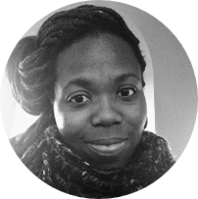
Akua Banful – Key Expert
Professional experience
Education and skills
Currently an Instructor in Columbia University’s University Writing Program
Design and teach a course for 14 undergraduate students that covers the rubrics and methods of writing and research required for academic writing
Formerly a Consulting Intern with Injaro Agricultural Capital Holdings Ltd, Accra
Investigated demand for locally produced roasted cashew nuts and recommended market entry strategy for local producer, with a plan for successful performance against competition
Measured and evaluated progress of the cashew producer relative to the production targets set by the venture capital fund worth USD $7 million maintained by the organization
Akua is currently working towards her Ph.D. in English and Comparative Literature at Columbia University in the City of New York; her research focusses on representations of landscape and conflict in African and African diasporic literature.
She also holds an MA, and MPhil. in English and Comparative Literature from Columbia, as well as a B.A. in Comparative Literature from Princeton University
Akua speaks English, and Portuguese fluently, she also has professional speaking and reading proficiency in French, Italian and Twi
Introduction
Akua is a scholar of literature and culture with an interest in and experience with consulting and legal environments. Attention to detail and effective writing are my specializations; language learning and communication are my professional passions.

